Slide 1
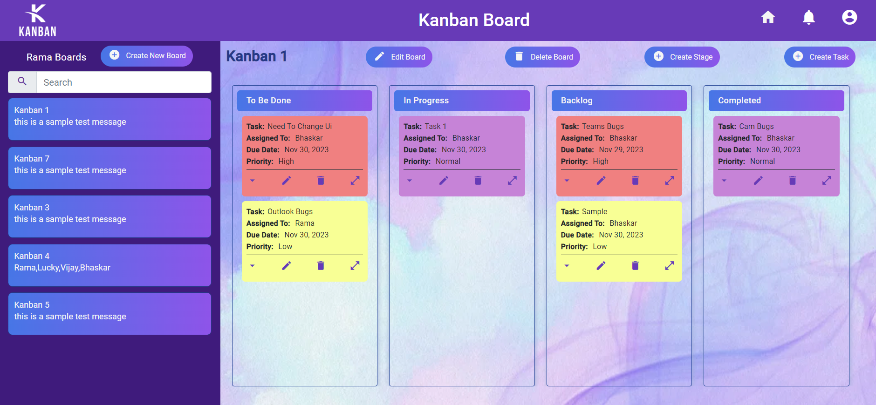
Project – Kanban Board
Prepared by,
Baskaran A,
Rama Lakshman A,
Mayuri

Slide 2



Meet Our Team Kanban
Mayuri Khope
B.Tech (Civil)
Baskaran A
BE- Automobile
Annapareddy Rama lakshman B.Tech (E.C.E)

Slide 3
Contents
Problem Statement
Introduction to project
Benefits & Features
Tools & Technologies
Class Diagram
Architecture Diagram
Working of Kanban
Future Enhancements
Conclusion
Bibliography

Slide 4
Problem Statements
Develop a Single-Page Application (SPA) adhering to the Single Responsibility Principle (SRP) and Don't Repeat Yourself (DRY) principles.
User Interface should be pleasing.
Send email notifications upon completing each task, keeping team members informed and engaged.
Implement email notifications for successful user sign-up, providing users with confirmation and necessary details.
Enforce Work In Progress (WIP) limits for each team member within the In-Progress stage to optimize workflow and prevent task overload.
Develop a system to generate and send notifications upon completing each task, creating a real-time feedback mechanism for users.

Slide 5
Introduction to Project
Kanban is a workflow management method that allows project managers to visualize their team’s work on easy-to-use boards that facilitate planning, scheduling, and tracking work.
Kanban's visual nature makes it easy for team members to see the flow of work at a glance.
Work items in Kanban are represented by cards on the board and Each card contains essential information about the task, making it easy to understand and prioritize.
Kanban allows teams to define and adapt their workflows based on the unique needs of their projects.

Slide 6
Benefits & Features of Kanban Board
Visual Workflow Management:
Feature: Tasks are represented visually on the board.
Benefit: Enhances transparency and allows teams to quickly understand the status of work.
Limiting Work in Progress (WIP):
Feature: WIP limits prevent overloading teams with too many tasks.
Benefit: Ensures focus on completing existing tasks before taking on new ones.
Workflow Stages:
Feature: Board is divided into stages representing the workflow.
Benefit: Clearly defines the progression of tasks through different stages.
Team Collaboration Tools:
Feature: Integration with collaboration tools for real-time communication.
Benefit: Improves teamwork and coordination among team members.

Slide 7





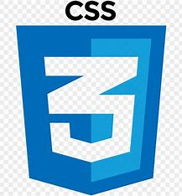


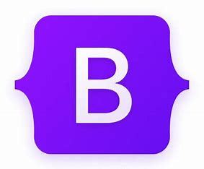

Tools & Technologies

Slide 8
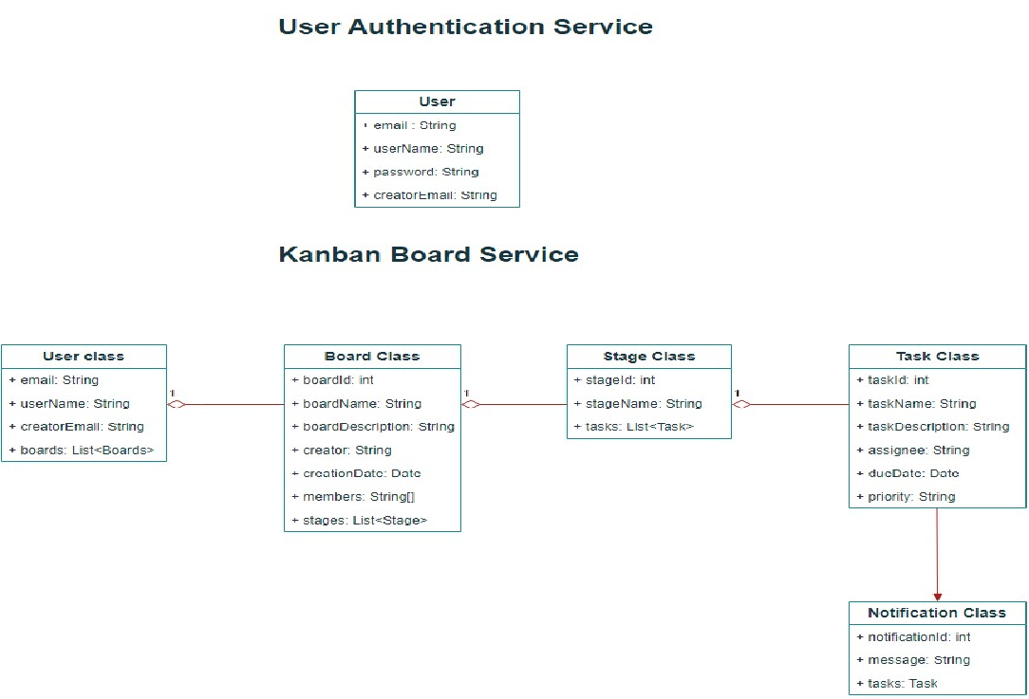
Class Diagram

Slide 9
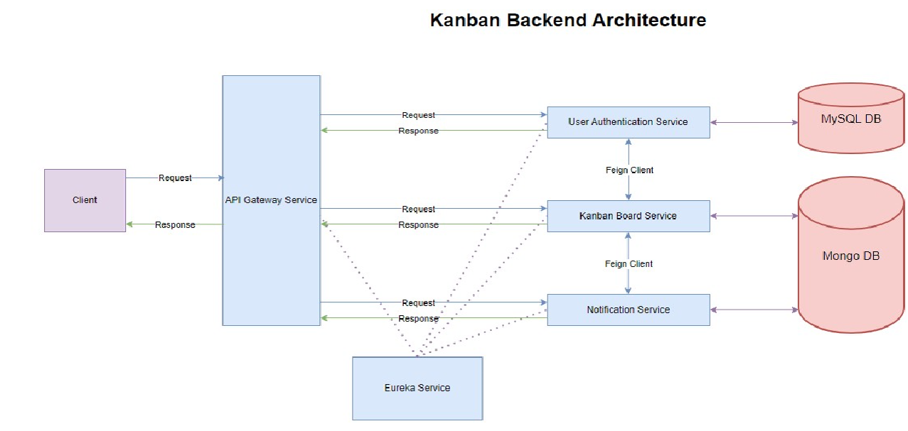
Architecture Diagram

Slide 10
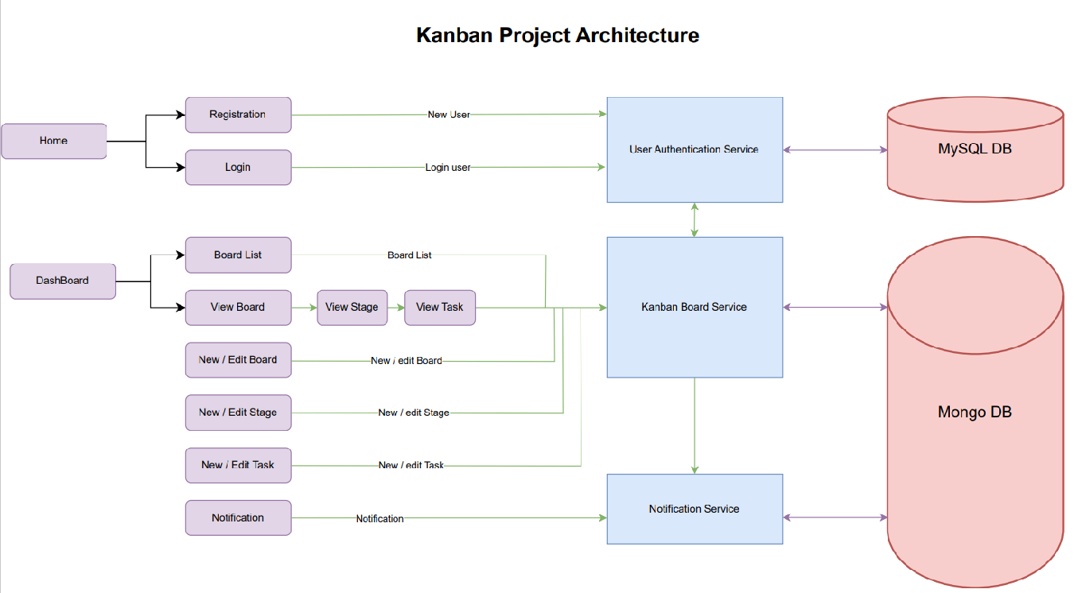
Architecture Diagram

Slide 11
Working of Kanban Board
Only authorized users can access the Kanban dashboard.
The user can add the team members to the board and members will get permission to access the board through login.
Creation of the new board will have 4 stages as default stages and they are To be done, In progress, backlog, and completed.
New tasks can be added only to the To be done stage.
Each task can be assigned to only one member from the team members list.
Tasks can be moved to different stages.
Each member can have a maximum of 2 tasks in In progress stage.
When the task is completed, the user can see that message in the notification tab.

Slide 12
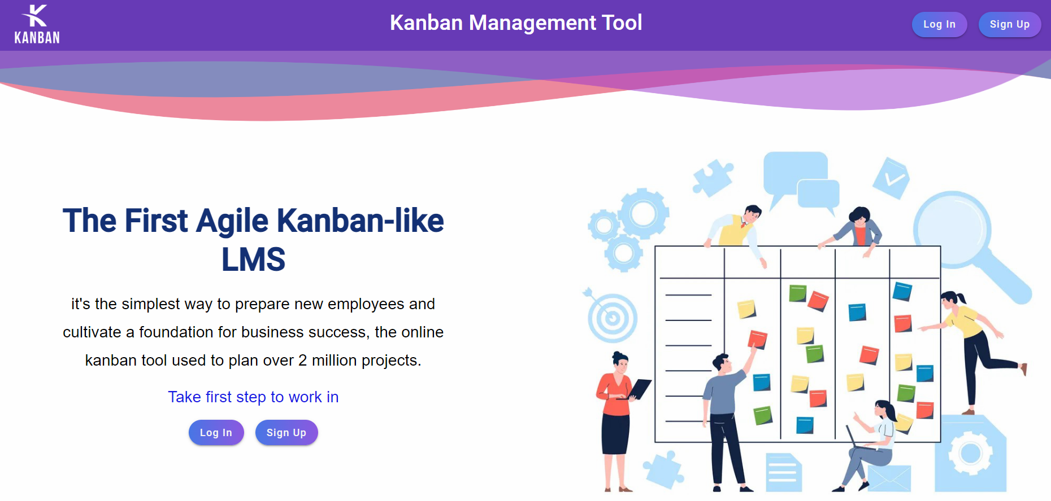
Demonstration

Slide 13
Future Enhancement
Implementation of drag and drop feature for tasks.
Implement a sideNav feature for the boardList view.
Implement the edit profile option

Slide 14
Conclusion
Single page application for Kanban Board is created using the angular framework.
JWT is used to authorize users to the dashboard.
User login information saved in Mysql database.
Board information saved in Mongo database.

Slide 15


Slide 16
Bibliography
For Spring boot application: https://spring.io/
For Angular framework: https://angular.io/
For Angular Materials: https://material.angular.io/
For CSS: https://getbootstrap.com/
For CSS: https://fonts.google.com/icons
Kanban board ref: https://kanbantool.com/kanban-board
Kanban board ref: https://trello.com/

Slide 17
Thank You

